Slide 1
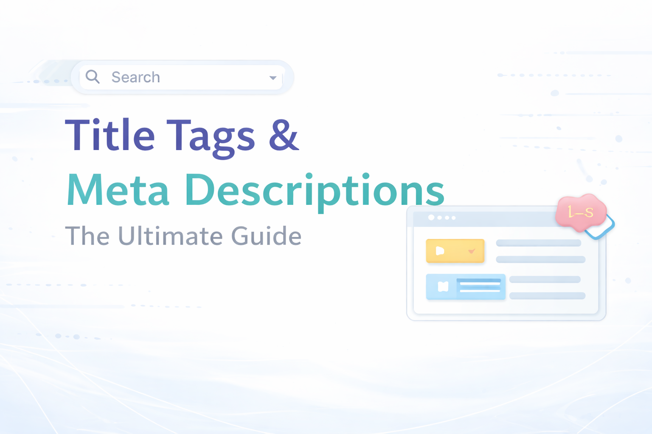


Slide 2

Ingoude Company
WHAT IS A TITLE TAG?
Think of a title tag as the headline of your webpage. It’s the first thing people notice when your page shows up on Google, and honestly, it often decides whether they click or scroll past.
02

Slide 3

HOW TO WRITE A TITLE TAG THAT WORKS
Keep it short — around 50–60 characters
Put your main keyword near the beginning
Make it sound natural, not forced
Add your brand name if it makes sense
Explore the full guide on Title tags & Meta Description
03

Slide 4

Contact
META DESCRIPTION
A meta description is the short paragraph under your title in search results. It’s like your quick pitch to the reader
Html Code
<meta name="description" content="Discover the best budget smartphones in 2026 with expert reviews, comparisons, and buying tips.">
04

Slide 5

Why Meta Descriptions Are Important
Gives people a reason to click
01
Summarizes your content clearly
02
Makes your result stand out
03
Adds a human touch to your search result
04
05

Slide 6
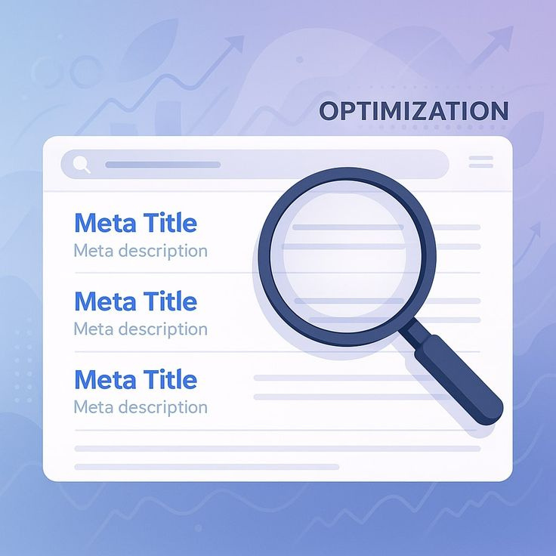

HOW TO WRITE ONE THAT GETS CLICKS
Stay within 150–160 characters
Use your keyword naturally (don’t force it)
Add a little curiosity or value
Speak directly to the reader
06

Slide 7


QUICK COMPARISON
Meta Description
Title Tag
The headline
Impacts rankings
Short and sharp
The summary
Impacts clicks
Slightly more detailed
07

Slide 8

A FEW REAL-WORLD TIPS
Don’t write like a robot, write as you talk
Avoid repeating keywords unnaturally
Make every page unique
Think: “Would I click this?”
08

Slide 9

FUTURE
Search engines may rewrite tags using AI
Focus shifting to user intent over keywords
Voice search needs more natural descriptions
More competition with featured snippets
Personalised search results will increase
09

Slide 10

Title tags & meta descriptions are key for SEO
01
They create the first impression on search results
02
Help improve click-through rate (CTR)
03
Must be clear, relevant, and engaging. Good optimisation = more traffic
CONCLUSION
04
10

